Slide 1
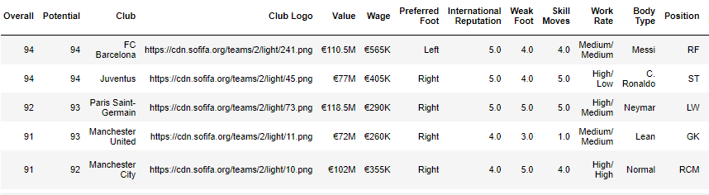
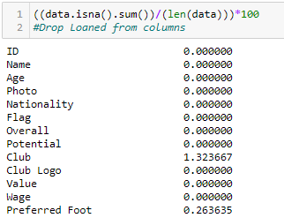
FIFA DATASET
Imported the Dataset FIFA and got the First 5 records :
Checked for the missing values and dropped them according the standard required percentages to drop example for rows the missing value percentage must be less than 10% and for columns if the missing value percentage is greater than 40% we drop them

Slide 2
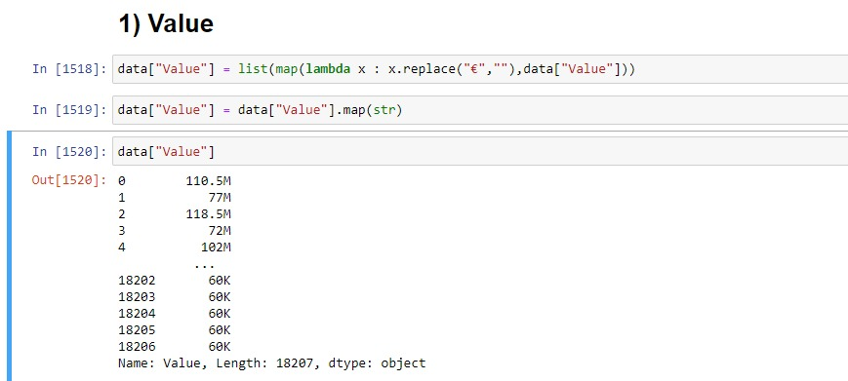
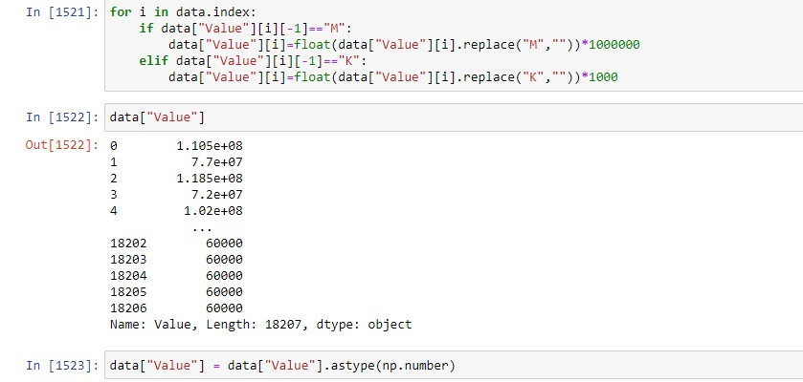
Changing the Columns Format
Removed the symbol in the value column
Removed the M and K Symbols and imputed those values with millions and thousands

Slide 3
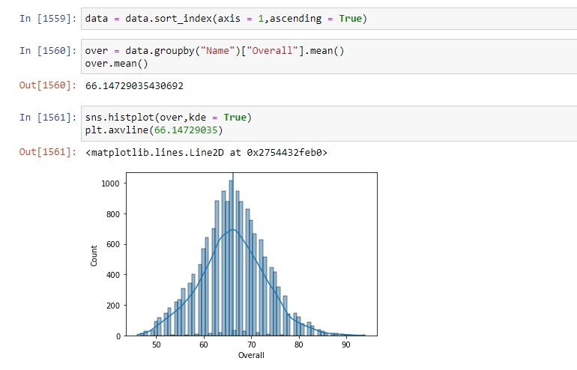
1.Plot the distribution of Overall rating for all players.
This is a normal distribution curve and the mean is found

Slide 4
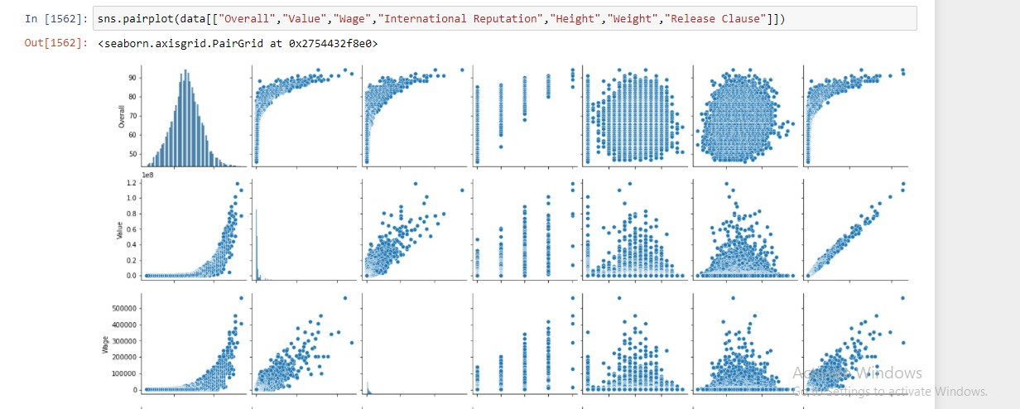
2.Generate pair plots for the following variables: Overall, Value, Wage, International Reputation, Height, Weight, Release Clause
The pair plot is visualized based on the given columns

Slide 5
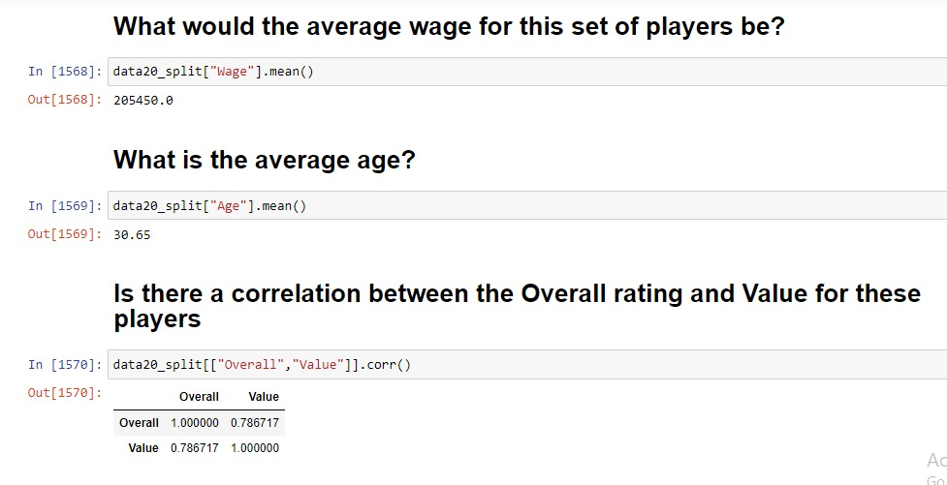
3. a.What would the average wage for this set of players be? b.What is the average age? c.Is there a correlation between the Overall rating and Value for these players?

Slide 6
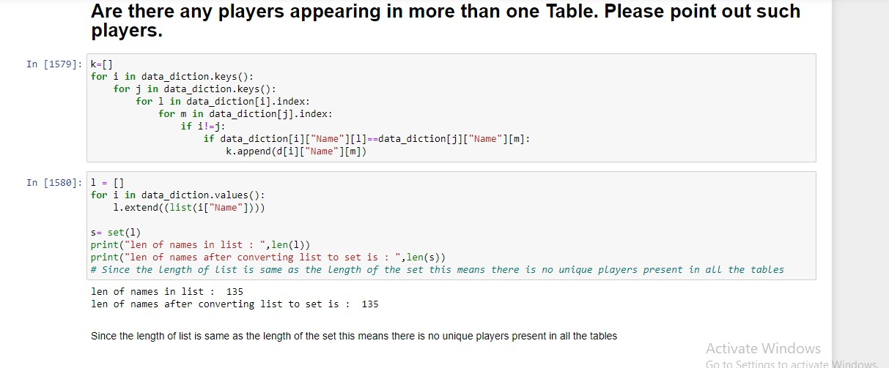
4. A.Are there any players appearing in more than one Table. Please point out such players.
1. one way is directly insering the unique values into the list using for loop which checks if each player is present in different tables
2.this method is used to check if there are unique players using set and list method have appended all the player names in a list and converted the list into set if the length list of players matches the length of set of players then there are no
unique players else there are unique players

Slide 7
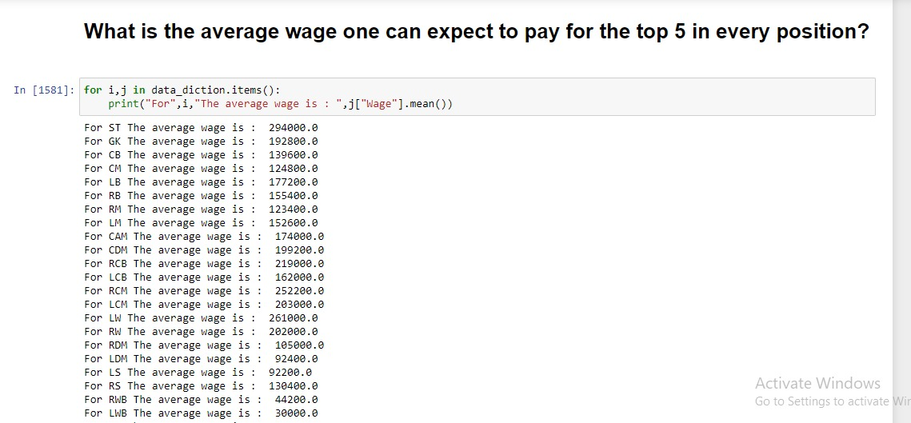
4. B.What is the average wage one can expect to pay for the top 5 in every position?
1.Position ST has the Hghest average wage
2.Position LAM has the lowest aveage wage

